Slide 1

Machine Learning for Cyber Security
Week 3
Mesut GUVEN, Ph.D.

Slide 2
information
Exams; 55% (Mid 25% + Final 30%), Homeworks; 15%, Project; 30%
In homeworks, you will be expected to examine SCI/E papers (published in last 3 years).
In Final Project, you will implement an AI/ML-based cyber solution.
Textbook:
- Getting Started with Deep Learning: Programming and Methodologies using Python
- Hands-On Machine Learning with Scikit-Learn, Keras, and TensorFlow, 2nd Edition
Code: GitHub
Videos: YouTube

Slide 3
UNIT 3: ML pipeline and cybersecurity example
Learning Outcomes;
- have a better understanding of ML pipeline,
- have a better understanding of how to prepare Cyber Security data for ML pipeline,
- Learn how to use Machine Learning to solve Cyber Security problems.

Slide 4
Example
TASK: Let’s imagine we want to detect the type of connected IoT devices Network packets;
Alexa
Assistant
Misc
IP
camera
TCP/IP
?
Network
Mobile
Power Outlet

Slide 5
Example
Network packets; information sent trough network cable 01101011101011101011111,
We can have the network traffic via wireshark/tcpdump/libpcap
What are the Features?
Do the labels exist or not? Supervised or Unsupervised
What are the Classes?
Data
Vector Space Representation
Label?
How much data do I have?

Slide 6
Example
HOW CAN WE CREATE A FORMAT FOR KNN/SVM/DT?
We should convert the data (network packets here, it can be either TCP, UDP or ICMP, etc ) into vector space consisting of features. There are several protocols but in general, they all have pieces of information (1 to 20 bytes) in a sequence such as;
We could investigate PAYLOAD, but in most of the attacks, the payload is encrypted and by definition ”something that is encrypted is also random”. So, ML algorithms can not find any pattern in random data”.
ETHERNET HEADER | IP HEADER | TCP/UDP HEADER | PAYLOAD (DATA)

Slide 7
Example
For classification, we should create samples with features (X matrice) and corresponding labels (Y matrice).
Features are extracted form TCP and IP header fields. Approximately there are 40 possible features that can be extracted from pcap files of these fields.
In our IoT device scenario, we have 5 classes, 0 = Camera, 1 = Mobile, .... 4 = Miscellenaus, etc.
FW
Router
F₁ F₂ F₃ …. ….F_{n} C [0-4]
SW
S1
S2
S3
0
S1
S2
Alexa
Camera
IP/TCP
TCP/IP
✘ UDP/IP
X
Y

Slide 8
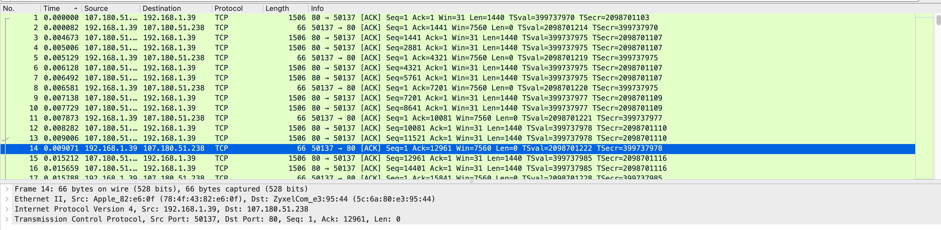
Example
Define the SAMPLE: 1. Each rows in the .pcap file or 2. The average of rows in a window.
For example; in a 0.01 seconds-long frame, there are 14 samples (see figure) and, if we use the window approach, the sum of the lengths are divided to 14.

Slide 9
Example
DATASET CONSTRUCTION: LABELS can be extracted as;
If system administrator can provide ground truth policy information for devices’ IP address, we can judge the device type by the source IP address of the package. For example, lets assume each IP address of the device is 192.186.1.#, and # is replaced by:
Mobile: 45; Outlet: 222,67; Assistant: 111,30,42,59,70; Camera: 128,145,78; Miscellaneous: 216,46,84,91; By creating a dictionary, we can form the labels of each packet such as;
HW: You are required to define filtering strings for the other 3 devices (Assistant, Camera, Miscellaneous).

Slide 10
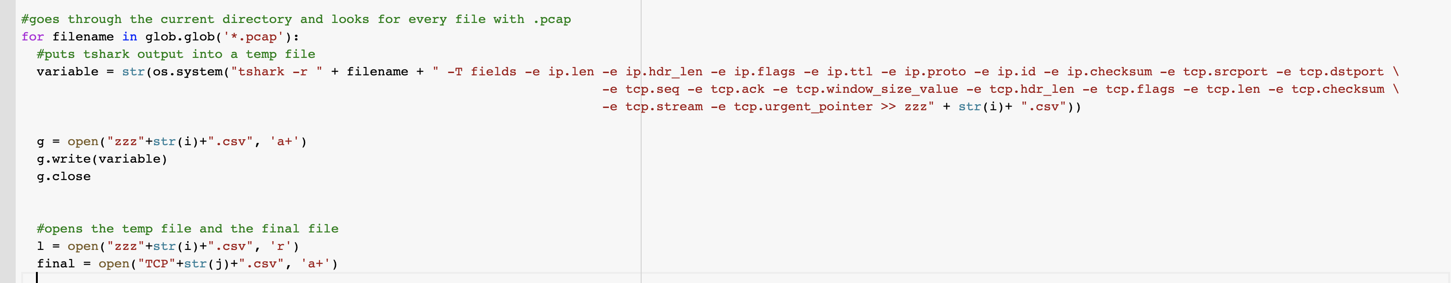
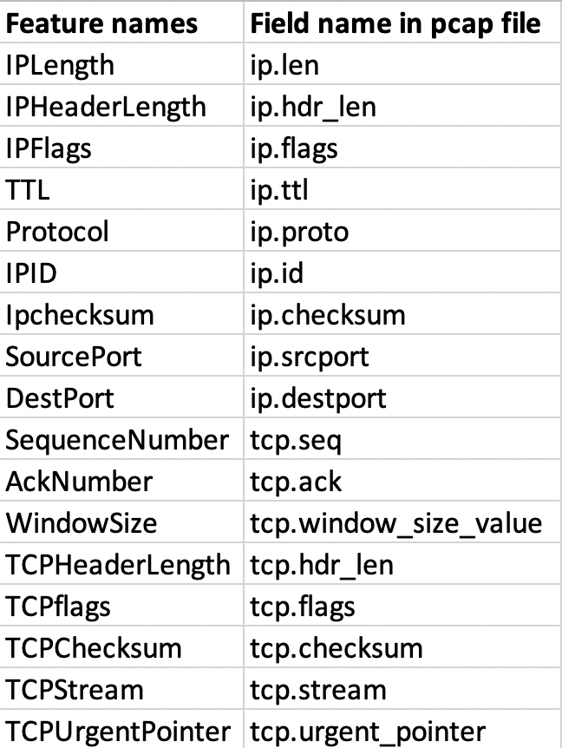
DATASET CONSTRUCTION: FEATURES can be extracted as;
The features shown in Figure can be extracted from the .pcap file by using “tshark” command.
-T option should be selected if you want to use -e option
-r means to read the local pcap file,
Use several -e options for each feature (field) that you want to extract from the pcap file, such as -e ip.len

Slide 11
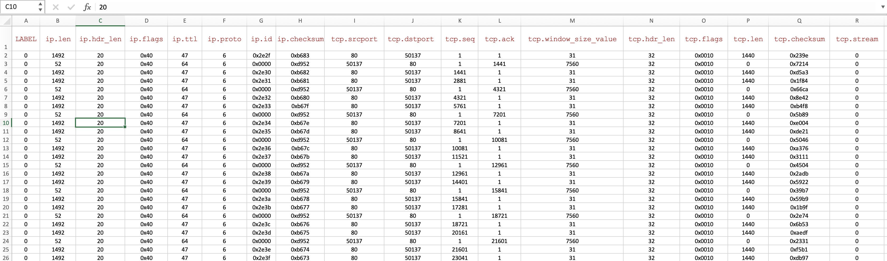
TCP.CSV

Slide 12
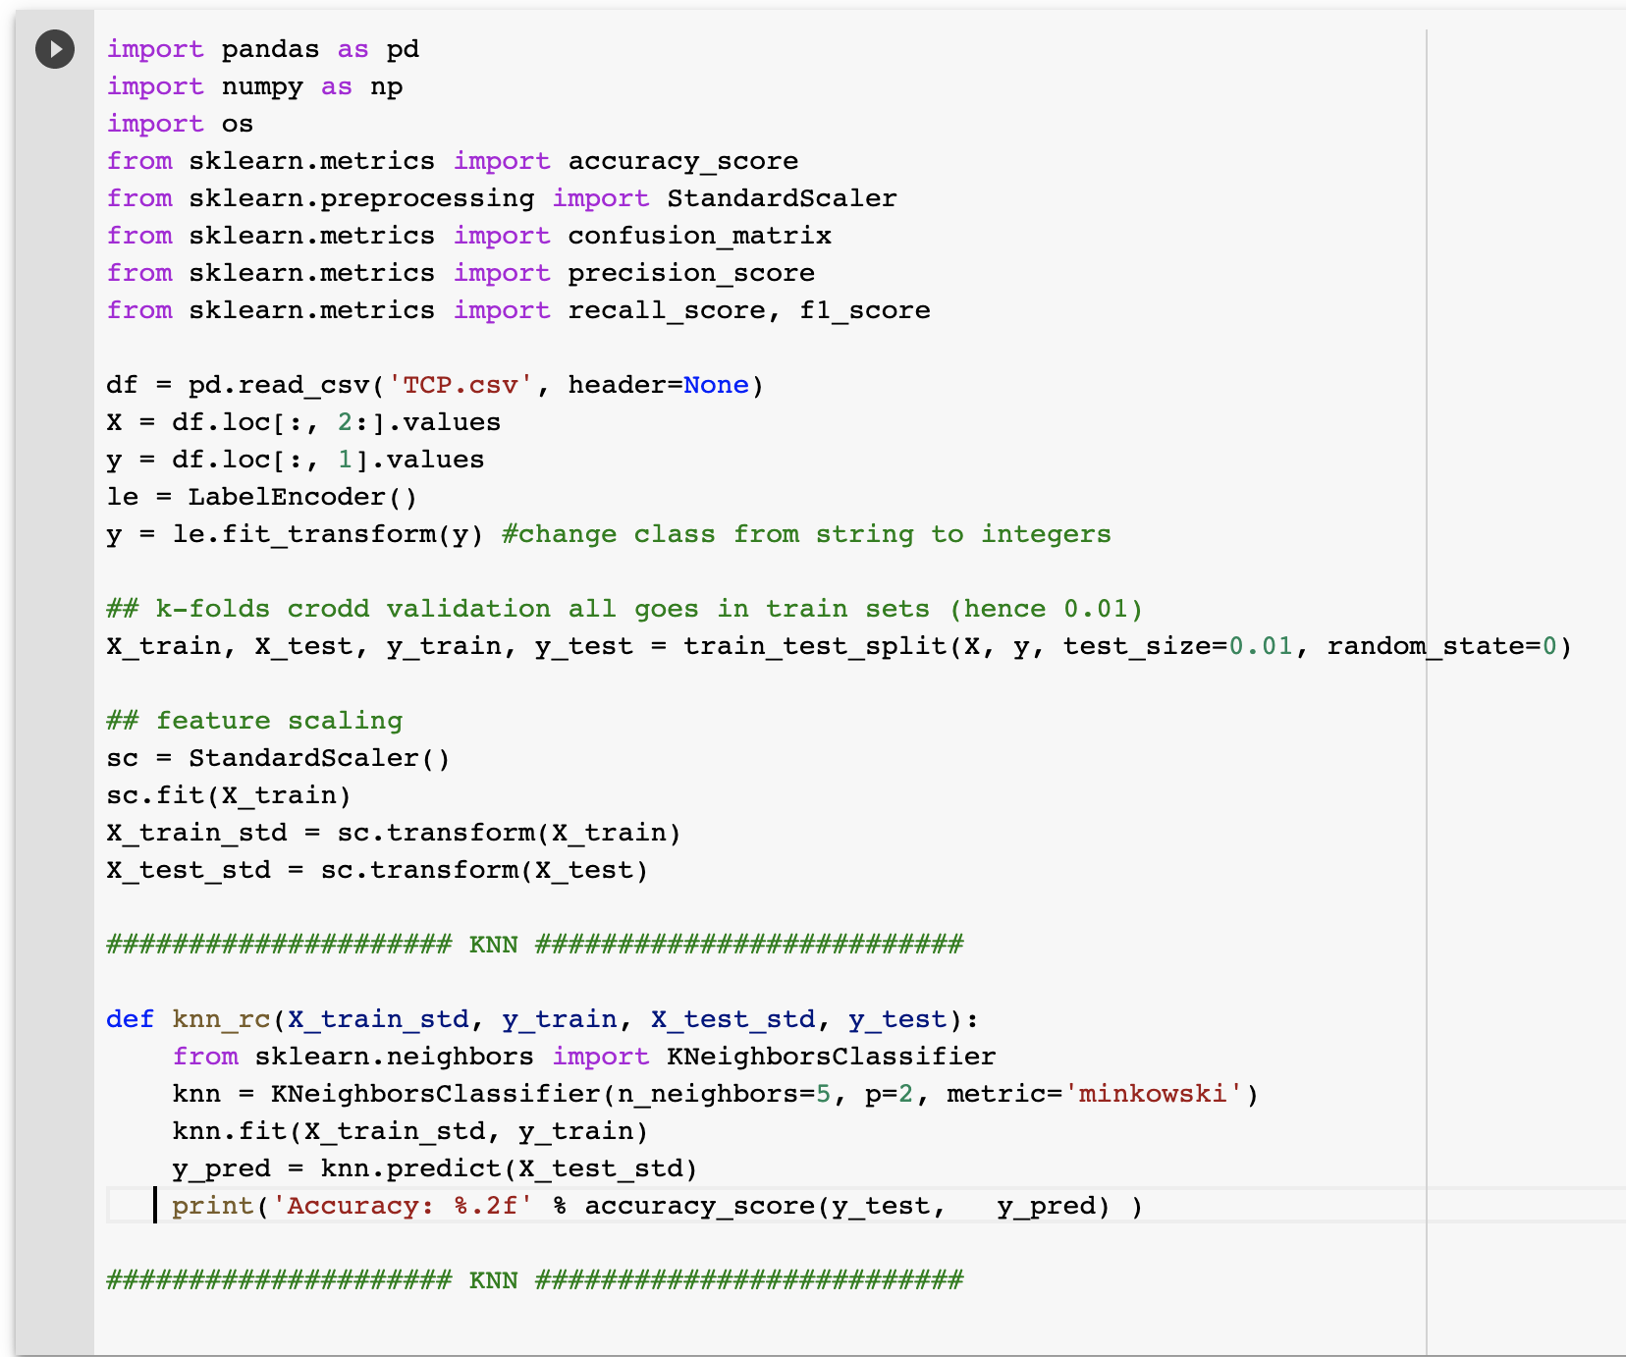
Example
We have a labeled dataset (a .csv file). So, we can now predict the new sample’s label by computing its closest k neighbors. Save 90% for training and 10% for test,
Before implementation, features should be normalized between [0-1].
Using “sklearn” normalization and KNN/SVM/DT can be handled.
TCP.CSV

